Slide 1
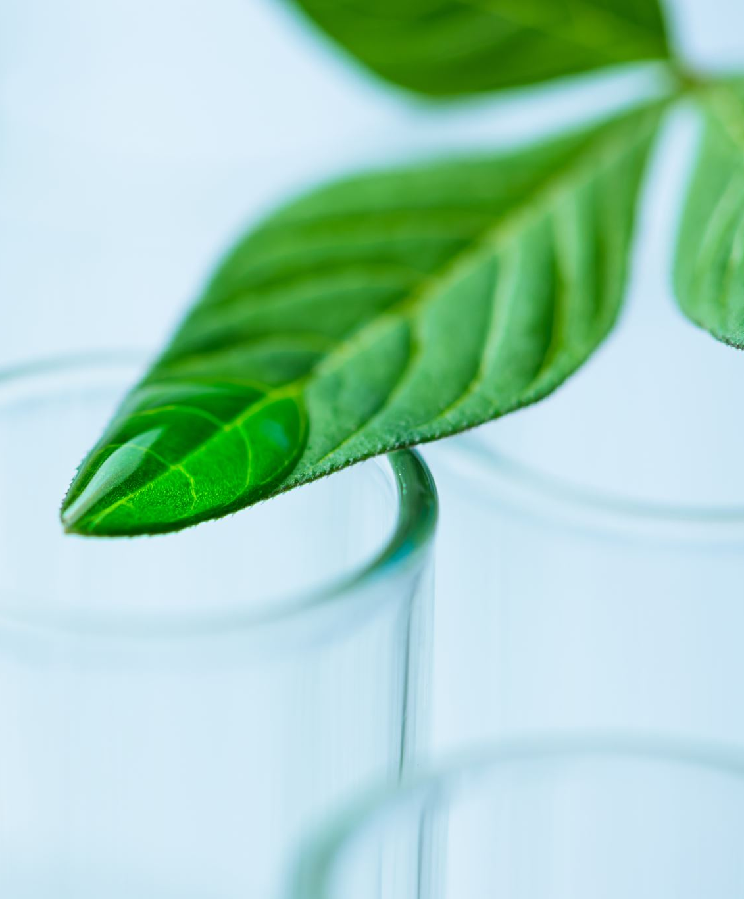
rice Plant Disease Detection
Team Members :
Under the guidance of

Slide 2

Agenda
Abstract
Introduction
Existing Systems
Proposed System
Data Set
Algorithm
Output Screen
Conclusion

Slide 3
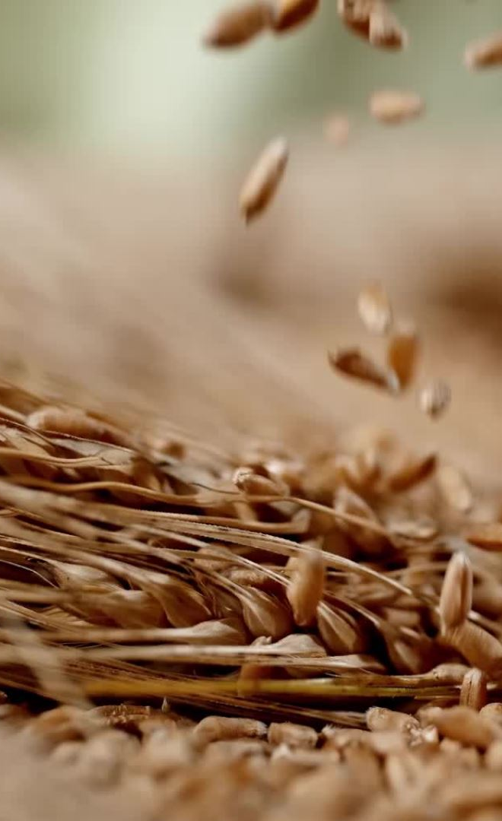
Agenda
Rice is one of the most widely consumed food throughout the world and is the third highest world-wide production. Rice plant diseases cause major damage to the yield of the final production and quality of rice.
It is estimated that approximately 37% of the yield is reduced due to various diseases every year. So early detection and treatment of the disease plays a prominent role in controlling the damage. Due to a variety of diseases in Rice crop, it is not easy to diagnose the type of it based on the impact it causes on the crop i.e., colour of the leaf and stem.
With Advancements in AI, rice disease detection models are developed, and objective of our project is to fine tune the existing models by appllying GEN AI techniques, regularization and hyper parameter tuning.

Slide 4
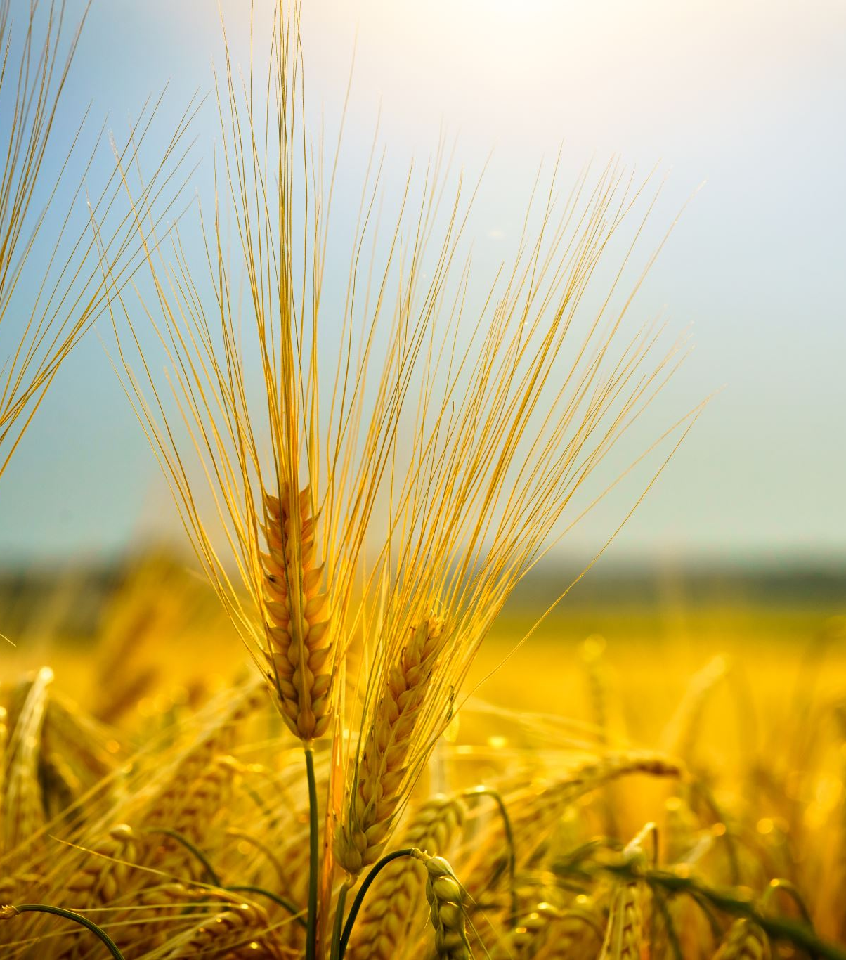
Introduction
Of the three major crops – rice, wheat and maize – rice is by far the most important food crop for people in low- and lower-middle-income countries. Although rich and poor people alike eat rice in low-income countries, the poorest people consume relatively little wheat and are therefore deeply affected by the cost and availability of rice.
In many Asian countries, rice is the fundamental and generally irreplaceable staple, especially of the poor. For the extreme poor in Asia, who live on less than $1.25 a day, rice accounts for nearly half of their food expenditures and a fifth of total household expenditures, on average. Rice is critical to food security for many of the world’s poor people.

Slide 5
Existing systems
Machine Learning (ML) Models for image classification like Support Vector Machine were used in the previous literature.
Deep Learning (DL) techniques like Convolutional Neural Networks (CNN) was also used for rice plant disease detection.
The above used techniques have limitations with respect to classification accuracy.

Slide 6
Proposed system
As part of our project work, we have developed a customized CNN model blended with GEN AI techniques and successfully achieved better accuracy over existing systems. We also created synthetic data for increased training, applied hyper parameter fine tuning, and able to achieved better accuracy.
Outcomes: Validation accuracy improved by 5%
Overall classification accuracy is 94.3%

Slide 7
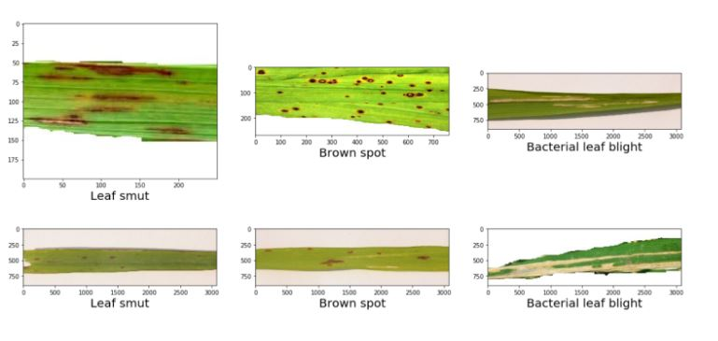
Dataset
This dataset contains 120 jpg images of disease infected rice leaves. The images are grouped into 3 classes based on the type of disease. There are 40 images in each class.
Classes
Leaf smut
Brown spot
Bacterial leaf blight

Slide 8
algorithm
Generate Synthetic Data using Generative Adversarial Networks (GAN)
Merge synthetic data with original data set
Train the CNN models with updated data set
Apply L1 and L2 regularization for feature selection and weight distribution appropriately.
Train and test the model
Find accuracy using Receiver Operating Characteristics (RoC) curve.

Slide 9
System design
Load Data set
Generate Synthetic Data using GAN
Merge datasets
Train CNN
Evaluate
Train and test
Customize CNN

Slide 10
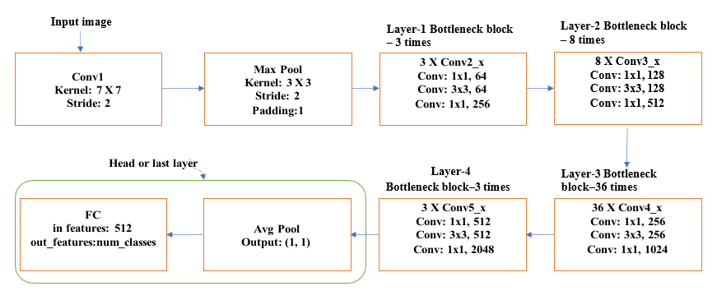
Fully connected cnn

Slide 11
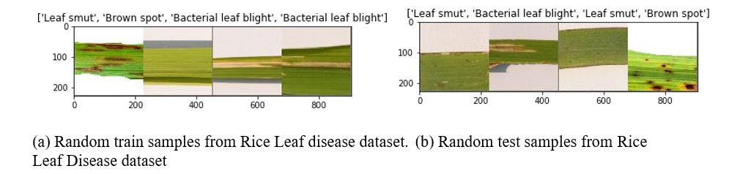
Random train and test samples

Slide 12
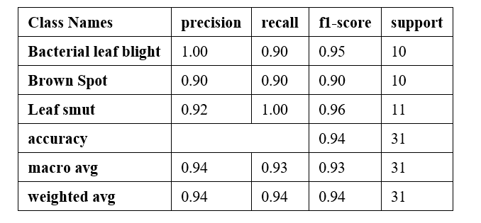
Classification report on test images

Slide 13
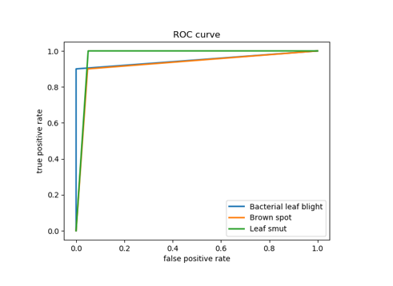
Roc curve on test images
Validation accuracy increased by 5% and overall accuracy is 94.3%
Link to Python notebook for code
https://colab.research.google.com/drive/1se-x1nVkbdTqMg5KP2C94nlowuNyGqL-?usp=sharing

Slide 14
Conclusion
Improved model for rice disease detection was developed.
Validation accuracy improved.
Overall accuracy improved.

